Slide 1
Functions
Introduction

Slide 2
Function - Introduction
Definition: Let A and B be nonempty sets. A function f from A to B, denoted f: A → B is an assignment of each element of A to exactly one element of B

Slide 3
Function - Introduction
Definition: Let A and B be nonempty sets. A function f from A to B, denoted f: A → B is an assignment of each element of A to exactly one element of B
We write f(a) = b if b is the unique element of B assigned by the function f to the element a of A

Slide 4
Function - Introduction
Definition: Let A and B be nonempty sets. A function f from A to B, denoted f: A → B is an assignment of each element of A to exactly one element of B
We write f(a) = b if b is the unique element of B assigned by the function f to the element a of A
Functions are sometimes called mappings or transformations

Slide 5
Function - Introduction
Example:
Students
Grades
A
Carlota Rodriguez
B
Sandeep Patel
C
Jalen Williams
D
F
Kathy Scott

Slide 6
Function - Introduction
Definition: A function f: A → B can also be defined as a subset of A×B (a relation). This subset is restricted to be a relation where no two elements of the relation have the same first element

Slide 7
Function - Introduction
Definition: A function f: A → B can also be defined as a subset of A×B (a relation). This subset is restricted to be a relation where no two elements of the relation have the same first element
Specifically, a function f from A to B contains one and only one ordered pair (a, b) for every element a∈ A

Slide 8

Function - Introduction
Definition: A function f: A → B can also be defined as a subset of A×B (a relation). This subset is restricted to be a relation where no two elements of the relation have the same first element
Specifically, a function f from A to B contains one and only one ordered pair (a, b) for every element a∈ A

Slide 9
Function - Introduction
A function f: A → B, means f maps A to B or f is mapping from A to B

Slide 10
Function - Introduction
A function f: A → B, means f maps A to B or f is mapping from A to B
Domain: A is called the domain of f

Slide 11
Function - Introduction
A function f: A → B, means f maps A to B or f is mapping from A to B
Domain: A is called the domain of f
Codomain: B is called the codomain of f

Slide 12
Function - Introduction
A function f: A → B, means f maps A to B or f is mapping from A to B
Domain: A is called the domain of f
Codomain: B is called the codomain of f
Image: If f(a) = b, then b is called the image of a under f

Slide 13
Function - Introduction
A function f: A → B, means f maps A to B or f is mapping from A to B
Domain: A is called the domain of f
Codomain: B is called the codomain of f
Image: If f(a) = b, then b is called the image of a under f
Preimage: If f(a) = b, then a is called the preimage of b

Slide 14
Function - Introduction
A function f: A → B, means f maps A to B or f is mapping from A to B
Domain: A is called the domain of f
Codomain: B is called the codomain of f
Image: If f(a) = b, then b is called the image of a under f
Preimage: If f(a) = b, then a is called the preimage of b
Range: The range of f is the set of all images of points in A under f. We denote it by f(A)

Slide 15
Function - Introduction
A function f: A → B, means f maps A to B or f is mapping from A to B
Domain: A is called the domain of f
Codomain: B is called the codomain of f
Image: If f(a) = b, then b is called the image of a under f
Preimage: If f(a) = b, then a is called the preimage of b
Range: The range of f is the set of all images of points in A under f. We denote it by f(A)
Equal Functions: Two functions are equal when they have the same domain, the same codomain and map each element of the domain to the same element of the codomain

Slide 16
Function - Example
A
B
a
x
b
y
c
d
z

Slide 17
Function - Example
f(a) =
A
B
a
x
b
y
c
d
z

Slide 18
Function - Example
f(a) = z
A
B
a
x
b
y
c
d
z

Slide 19
Function - Example
f(a) = z
The image of d? =
A
B
a
x
b
y
c
d
z

Slide 20
Function - Example
f(a) = z
The image of d? = z
A
B
a
x
b
y
c
d
z

Slide 21
Function - Example
f(a) = z
The image of d? = z
The domain of f ? =
A
B
a
x
b
y
c
d
z

Slide 22
Function - Example
f(a) = z
The image of d? = z
The domain of f ? = A
A
B
a
x
b
y
c
d
z

Slide 23
Function - Example
f(a) = z
The image of d? = z
The domain of f ? = A
The codomain of f ? =
A
B
a
x
b
y
c
d
z

Slide 24
Function - Example
f(a) = z
The image of d? = z
The domain of f ? = A
The codomain of f ? = B
A
B
a
x
b
y
c
d
z

Slide 25
Function - Example
f(a) = z
The image of d? = z
The domain of f ? = A
The codomain of f ? = B
The preimage of y ? =
A
B
a
x
b
y
c
d
z

Slide 26
Function - Example
f(a) = z
The image of d? = z
The domain of f ? = A
The codomain of f ? = B
The preimage of y ? = b
A
B
a
x
b
y
c
d
z

Slide 27
Function - Example
f(a) = z
The image of d? = z
The domain of f ? = A
The codomain of f ? = B
The preimage of y ? = b
f(A) =
A
B
a
x
b
y
c
d
z

Slide 28
Function - Example
f(a) = z
The image of d? = z
The domain of f ? = A
The codomain of f ? = B
The preimage of y ? = b
f(A) = {y, z}
A
B
a
x
b
y
c
d
z

Slide 29
Function - Example
f(a) = z
The image of d? = z
The domain of f ? = A
The codomain of f ? = B
The preimage of y ? = b
f(A) = {y, z}
The preimage of z ? =
A
B
a
x
b
y
c
d
z

Slide 30
Function - Example
f(a) = z
The image of d? = z
The domain of f ? = A
The codomain of f ? = B
The preimage of y ? = b
f(A) = {y, z}
The preimage of z ? = {a, c, d}
A
B
a
x
b
y
c
d
z

Slide 31
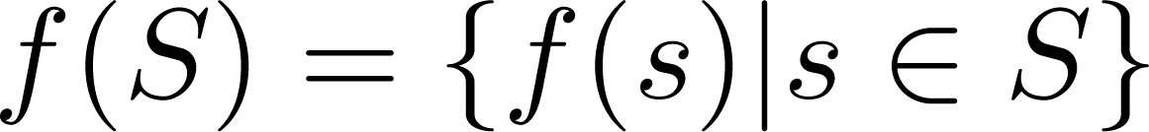
Function – Example 01
If f: A → B, and S is a subset of A, then
A
B
a
x
b
y
c
d
z

Slide 32
Function – Example 01
If f: A → B, and S is a subset of A, then
f {a,b,c} =
A
B
a
x
b
y
c
d
z

Slide 33
Function – Example 01
If f: A → B, and S is a subset of A, then
f {a,b,c} = {y, z}
A
B
a
x
b
y
c
d
z

Slide 34
Function – Example 01
If f: A → B, and S is a subset of A, then
f {a,b,c} = {y, z}
f {c, d} =
A
B
a
x
b
y
c
d
z

Slide 35
Function – Example 01
If f: A → B, and S is a subset of A, then
f {a,b,c} = {y, z}
f {c, d} = {z}
A
B
a
x
b
y
c
d
z

Slide 36
Function - Representation
Functions may be specified in different ways

Slide 37
Function - Representation
Functions may be specified in different ways
An Explicit Statement of the assignment
Students and grades example

Slide 38
Function - Representation
Functions may be specified in different ways
An Explicit Statement of the assignment
Students and grades example
A Formula
f(x) = x + 1

Slide 39
Function - Representation
Functions may be specified in different ways
An Explicit Statement of the assignment
Students and grades example
A Formula
f(x) = x + 1
A Computer Program
A Java program that when given an integer n, produces the nth Fibonacci Number

Slide 40
Function - Types
One – to – One or Injective

Slide 41
Function - Types
One – to – One or Injective
if and only if f(a) = f(b) implies that a = b for all a and b in the domain of f.

Slide 42
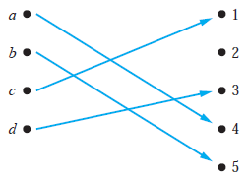
Function - Types
One – to – One or Injective
if and only if f(a) = f(b) implies that a = b for all a and b in the domain of f.

Slide 43
Function - Types
One – to – One or Injective
if and only if f(a) = f(b) implies that a = b for all a and b in the domain of f.
∀a∀b(f(a) =f(b)→ a=b)
∀a∀b(a≠b → f(a) ≠ f(b))

Slide 44
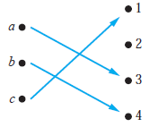
Function – Example 01
One – to – One or Injective
if and only if f(a) = f(b) implies that a = b for all a and b in the domain of f.

Slide 45

Function – Example 01
One – to – One or Injective
if and only if f(a) = f(b) implies that a = b for all a and b in the domain of f.

Slide 46
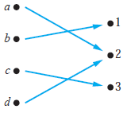
Function – Example 02
One – to – One or Injective
if and only if f(a) = f(b) implies that a = b for all a and b in the domain of f.

Slide 47

Function – Example 02
One – to – One or Injective
if and only if f(a) = f(b) implies that a = b for all a and b in the domain of f.

Slide 48
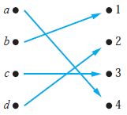
Function – Example 03
One – to – One or Injective
if and only if f(a) = f(b) implies that a = b for all a and b in the domain of f.

Slide 49
Function – Example 03
One – to – One or Injective
if and only if f(a) = f(b) implies that a = b for all a and b in the domain of f.

Slide 50
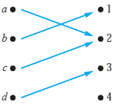
Function – Example 04
One – to – One or Injective
if and only if f(a) = f(b) implies that a = b for all a and b in the domain of f.

Slide 51
Function – Example 04
One – to – One or Injective
if and only if f(a) = f(b) implies that a = b for all a and b in the domain of f.

Slide 52
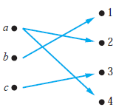
Function – Example 05
One – to – One or Injective
if and only if f(a) = f(b) implies that a = b for all a and b in the domain of f.

Slide 53
Function – Example 05
One – to – One or Injective
if and only if f(a) = f(b) implies that a = b for all a and b in the domain of f.
Not a function

Slide 54
Function – Example 06
Let f be the function from {a,b,c,d} to {1,2,3} defined by f(a) = 3, f(b) = 2, f(c) = 1, and f(d) = 3
One to one?

Slide 55
Function – Example 06
Let f be the function from {a,b,c,d} to {1,2,3} defined by f(a) = 3, f(b) = 2, f(c) = 1, and f(d) = 3
One to one?

Slide 56
Function – Example 07
Is the function f(x) = x² from the set of integers.
One to one?

Slide 57
Function – Example 07
Is the function f(x) = x² from the set of integers.
One to one?

Slide 58
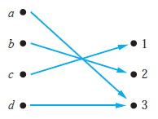
Function - Types
Onto or Surjective
if and only if for every element b ∈ B there is an element a ∈ A with f (a) = b.
∀y ∃x (f(x) = y)

Slide 59
Function – Example 01
Onto or Surjective
if and only if for every element b ∈ B there is an element a ∈ A with f (a) = b.

Slide 60
Function – Example 01
Onto or Surjective
if and only if for every element b ∈ B there is an element a ∈ A with f (a) = b.

Slide 61
Function – Example 02
Onto or Surjective
if and only if for every element b ∈ B there is an element a ∈ A with f (a) = b.

Slide 62
Function – Example 02
Onto or Surjective
if and only if for every element b ∈ B there is an element a ∈ A with f (a) = b.

Slide 63
Function – Example 03
Onto or Surjective
if and only if for every element b ∈ B there is an element a ∈ A with f (a) = b.

Slide 64
Function – Example 03
Onto or Surjective
if and only if for every element b ∈ B there is an element a ∈ A with f (a) = b.

Slide 65
Function – Example 04
Onto or Surjective
if and only if for every element b ∈ B there is an element a ∈ A with f (a) = b.

Slide 66
Function – Example 04
Onto or Surjective
if and only if for every element b ∈ B there is an element a ∈ A with f (a) = b.

Slide 67
Function – Example 05
Onto or Surjective
if and only if for every element b ∈ B there is an element a ∈ A with f (a) = b.

Slide 68
Function – Example 05
Onto or Surjective
if and only if for every element b ∈ B there is an element a ∈ A with f (a) = b.
Not a function

Slide 69
Function – Example 06
Let f be the function from {a,b,c,d} to {1,2,3} defined by f(a) = 3, f(b) = 2, f(c) = 1, and f(d) = 3
Onto?

Slide 70
Function – Example 06
Let f be the function from {a,b,c,d} to {1,2,3} defined by f(a) = 3, f(b) = 2, f(c) = 1, and f(d) = 3
Onto?

Slide 71
Function – Example 07
Is the function f(x) = x² from the set of integers.
Onto?

Slide 72
Function – Example 07
Is the function f(x) = x² from the set of integers.
Onto?

Slide 73
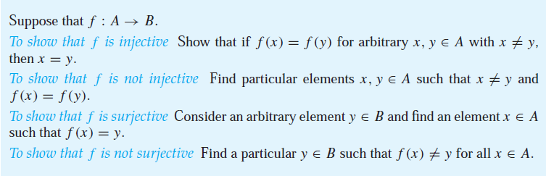
Function – Types
Summary

Slide 74
Function – Types
One – to – One Correspondence or Bijection
A function f is a one-to-one correspondence, or a bijection, if it is both one-to-one and onto (surjective and injective).

Slide 75
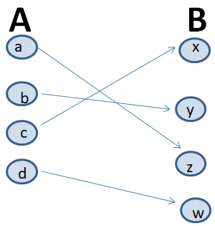
Function – Types
One – to – One Correspondence or Bijection
A function f is a one-to-one correspondence, or a bijection, if it is both one-to-one and onto (surjective and injective).

Slide 76
Function – Example 01
One – to – One Correspondence or Bijection
A function f is a one-to-one correspondence, or a bijection, if it is both one-to-one and onto (surjective and injective).

Slide 77
Function – Example 01
One – to – One Correspondence or Bijection
A function f is a one-to-one correspondence, or a bijection, if it is both one-to-one and onto (surjective and injective).

Slide 78
Function – Types
Inverse

Slide 79
Function – Types
Inverse
Let f be a bijection from A to B. Then the inverse of f, denoted f ⁻¹ , is the function from B to A defined as.

Slide 80
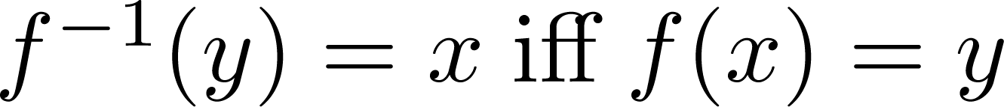
Function – Types
Inverse
Let f be a bijection from A to B. Then the inverse of f, denoted f ⁻¹ , is the function from B to A defined as.

Slide 81
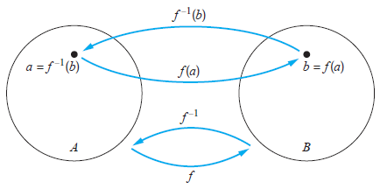
Function – Types
Inverse
Let f be a bijection from A to B. Then the inverse of f, denoted f ⁻¹ , is the function from B to A defined as.

Slide 82
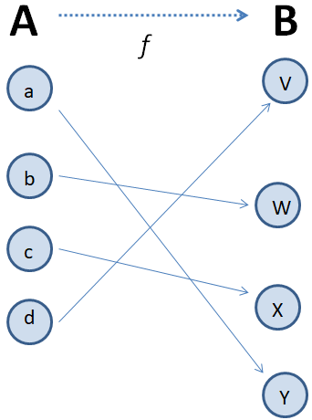
Function – Example 01
Inverse
Let f be a bijection from A to B. Then the inverse of f, denoted f ⁻¹ , is the function from B to A defined as.

Slide 83
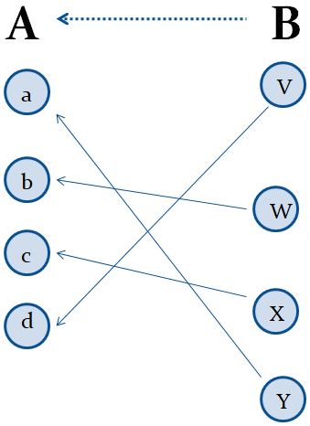
Function – Example 01
Inverse
Let f be a bijection from A to B. Then the inverse of f, denoted f ⁻¹ , is the function from B to A defined as.

Slide 84
Function – Example 02
Let f be the function from {a, b, c} to {1,2,3} such that f(a)=2, f(b) = 3, and f(c) = 1. Is f invertible and if so what is its inverse?

Slide 85
Function – Example 02
Let f be the function from {a, b, c} to {1,2,3} such that f(a)=2, f(b) = 3, and f(c) = 1. Is f invertible and if so what is its inverse?
The function f is invertible because it is a one-to-one correspondence. The inverse function f⁻¹ reverses the correspondence given by f, so

Slide 86
Function – Example 02
Let f be the function from {a, b, c} to {1,2,3} such that f(a)=2, f(b) = 3, and f(c) = 1. Is f invertible and if so what is its inverse?
The function f is invertible because it is a one-to-one correspondence. The inverse function f⁻¹ reverses the correspondence given by f, so
f⁻¹ (1) = c,

Slide 87
Function – Example 02
Let f be the function from {a, b, c} to {1,2,3} such that f(a)=2, f(b) = 3, and f(c) = 1. Is f invertible and if so what is its inverse?
The function f is invertible because it is a one-to-one correspondence. The inverse function f⁻¹ reverses the correspondence given by f, so
f⁻¹ (1) = c,
f⁻¹ (2) = a,

Slide 88
Function – Example 02
Let f be the function from {a, b, c} to {1,2,3} such that f(a)=2, f(b) = 3, and f(c) = 1. Is f invertible and if so what is its inverse?
The function f is invertible because it is a one-to-one correspondence. The inverse function f⁻¹ reverses the correspondence given by f, so
f⁻¹ (1) = c,
f⁻¹ (2) = a,
f⁻¹ (3) = b

Slide 89
Function – Example 03
Let f: Z → Z be such that f(x) = x + 1. Is f invertible, and if so, what is its inverse?

Slide 90
Function – Example 03
Let f: Z → Z be such that f(x) = x + 1. Is f invertible, and if so, what is its inverse?
The function f is invertible because it is a one-to-one correspondence. The inverse function f⁻¹ reverses the correspondence so

Slide 91
Function – Example 03
Let f: Z → Z be such that f(x) = x + 1. Is f invertible, and if so, what is its inverse?
The function f is invertible because it is a one-to-one correspondence. The inverse function f⁻¹ reverses the correspondence so
f⁻¹ (y) = y – 1

Slide 92
Function – Example 04
Let f: R → R be such that f(x) = x². Is f invertible, and if so, what is its inverse?

Slide 93
Function – Example 04
Let f: R → R be such that f(x) = x². Is f invertible, and if so, what is its inverse?
The function f is not invertible because it is not one-to-one

Slide 94
Function – Types
Composition

Slide 95
Function – Types
Composition
Let g: A → B, f: B → C; The composition of f with g, denoted f o g is the function from A to C defined by.

Slide 96
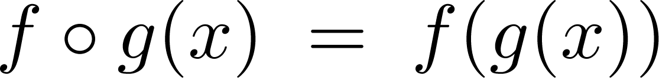
Function – Types
Composition
Let g: A → B, f: B → C; The composition of f with g, denoted f o g is the function from A to C defined by.

Slide 97
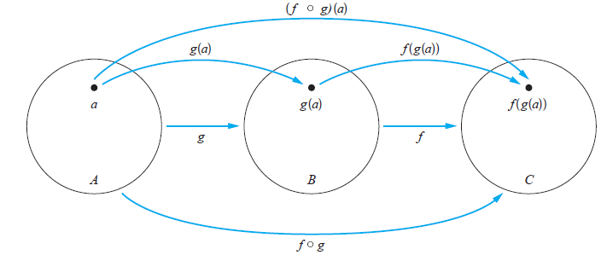
Function – Types
Composition
Let g: A → B, f: B → C; The composition of f with g, denoted f o g is the function from A to C defined by.

Slide 98
Function – Example 01
Composition
Let g: A → B, f: B → C; The composition of f with g, denoted f o g is the function from A to C defined by.

Slide 99
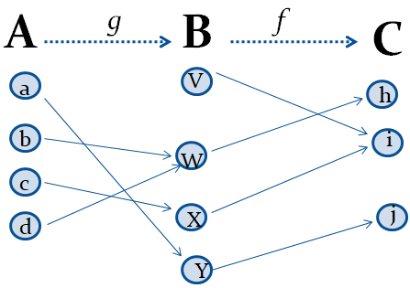
Function – Example 01
Composition
Let g: A → B, f: B → C; The composition of f with g, denoted f o g is the function from A to C defined by.

Slide 100
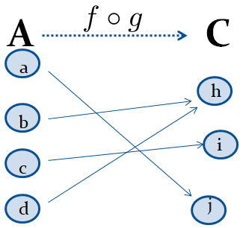
Function – Example 01
Composition
Let g: A → B, f: B → C; The composition of f with g, denoted f o g is the function from A to C defined by.

Slide 101
Function – Example 02
Composition
Let g: A → B, f: B → C; The composition of f with g, denoted f o g is the function from A to C defined by.
If f(x) = x² and g(x) = 2x + 1

Slide 102
Function – Example 02
Composition
Let g: A → B, f: B → C; The composition of f with g, denoted f o g is the function from A to C defined by.
If f(x) = x² and g(x) = 2x + 1
f o g

Slide 103
Function – Example 02
Composition
Let g: A → B, f: B → C; The composition of f with g, denoted f o g is the function from A to C defined by.
If f(x) = x² and g(x) = 2x + 1
f o g = f ( g(x))

Slide 104
Function – Example 02
Composition
Let g: A → B, f: B → C; The composition of f with g, denoted f o g is the function from A to C defined by.
If f(x) = x² and g(x) = 2x + 1
f o g = f ( g(x)) = f (2x + 1)

Slide 105
Function – Example 02
Composition
Let g: A → B, f: B → C; The composition of f with g, denoted f o g is the function from A to C defined by.
If f(x) = x² and g(x) = 2x + 1
f o g = f ( g(x)) = f (2x + 1) = (2x + 1)²

Slide 106
Function – Example 02
Composition
Let g: A → B, f: B → C; The composition of f with g, denoted f o g is the function from A to C defined by.
If f(x) = x² and g(x) = 2x + 1
f o g = f ( g(x)) = f (2x + 1) = (2x + 1)²
g o f

Slide 107
Function – Example 02
Composition
Let g: A → B, f: B → C; The composition of f with g, denoted f o g is the function from A to C defined by.
If f(x) = x² and g(x) = 2x + 1
f o g = f ( g(x)) = f (2x + 1) = (2x + 1)²
g o f = g ( f(x))

Slide 108
Function – Example 02
Composition
Let g: A → B, f: B → C; The composition of f with g, denoted f o g is the function from A to C defined by.
If f(x) = x² and g(x) = 2x + 1
f o g = f ( g(x)) = f (2x + 1) = (2x + 1)²
g o f = g ( f(x)) = g (x²)

Slide 109
Function – Example 02
Composition
Let g: A → B, f: B → C; The composition of f with g, denoted f o g is the function from A to C defined by.
If f(x) = x² and g(x) = 2x + 1
f o g = f ( g(x)) = f (2x + 1) = (2x + 1)²
g o f = g ( f(x)) = g (x²) = 2x² + 1

Slide 110
Function – Example 03
Let g be the function from the set {a,b,c} to itself such that g(a) = b, g(b) = c, and g(c) = a. Let f be the function from the set {a,b,c} to the set {1,2,3} such that f(a) = 3, f(b) = 2, and f(c) = 1

Slide 111
Function – Example 03
Let g be the function from the set {a,b,c} to itself such that g(a) = b, g(b) = c, and g(c) = a. Let f be the function from the set {a,b,c} to the set {1,2,3} such that f(a) = 3, f(b) = 2, and f(c) = 1
f o g

Slide 112
Function – Example 03
Let g be the function from the set {a,b,c} to itself such that g(a) = b, g(b) = c, and g(c) = a. Let f be the function from the set {a,b,c} to the set {1,2,3} such that f(a) = 3, f(b) = 2, and f(c) = 1
f o g = f ( g(a))

Slide 113
Function – Example 03
Let g be the function from the set {a,b,c} to itself such that g(a) = b, g(b) = c, and g(c) = a. Let f be the function from the set {a,b,c} to the set {1,2,3} such that f(a) = 3, f(b) = 2, and f(c) = 1
f o g = f ( g(a)) = f (b)

Slide 114
Function – Example 03
Let g be the function from the set {a,b,c} to itself such that g(a) = b, g(b) = c, and g(c) = a. Let f be the function from the set {a,b,c} to the set {1,2,3} such that f(a) = 3, f(b) = 2, and f(c) = 1
f o g = f ( g(a)) = f (b) = 2

Slide 115
Function – Example 03
Let g be the function from the set {a,b,c} to itself such that g(a) = b, g(b) = c, and g(c) = a. Let f be the function from the set {a,b,c} to the set {1,2,3} such that f(a) = 3, f(b) = 2, and f(c) = 1
f o g = f ( g(a)) = f (b) = 2
f o g

Slide 116
Function – Example 03
Let g be the function from the set {a,b,c} to itself such that g(a) = b, g(b) = c, and g(c) = a. Let f be the function from the set {a,b,c} to the set {1,2,3} such that f(a) = 3, f(b) = 2, and f(c) = 1
f o g = f ( g(a)) = f (b) = 2
f o g = f ( g(b))

Slide 117
Function – Example 03
Let g be the function from the set {a,b,c} to itself such that g(a) = b, g(b) = c, and g(c) = a. Let f be the function from the set {a,b,c} to the set {1,2,3} such that f(a) = 3, f(b) = 2, and f(c) = 1
f o g = f ( g(a)) = f (b) = 2
f o g = f ( g(b)) = f (c)

Slide 118
Function – Example 03
Let g be the function from the set {a,b,c} to itself such that g(a) = b, g(b) = c, and g(c) = a. Let f be the function from the set {a,b,c} to the set {1,2,3} such that f(a) = 3, f(b) = 2, and f(c) = 1
f o g = f ( g(a)) = f (b) = 2
f o g = f ( g(b)) = f (c) = 1

Slide 119
Function – Example 03
Let g be the function from the set {a,b,c} to itself such that g(a) = b, g(b) = c, and g(c) = a. Let f be the function from the set {a,b,c} to the set {1,2,3} such that f(a) = 3, f(b) = 2, and f(c) = 1
f o g = f ( g(a)) = f (b) = 2
f o g = f ( g(b)) = f (c) = 1
f o g = f ( g(c))

Slide 120
Function – Example 03
Let g be the function from the set {a,b,c} to itself such that g(a) = b, g(b) = c, and g(c) = a. Let f be the function from the set {a,b,c} to the set {1,2,3} such that f(a) = 3, f(b) = 2, and f(c) = 1
f o g = f ( g(a)) = f (b) = 2
f o g = f ( g(b)) = f (c) = 1
f o g = f ( g(c)) = f (a) = 3

Slide 121
Function – Example 03
Let g be the function from the set {a,b,c} to itself such that g(a) = b, g(b) = c, and g(c) = a. Let f be the function from the set {a,b,c} to the set {1,2,3} such that f(a) = 3, f(b) = 2, and f(c) = 1
f o g = f ( g(a)) = f (b) = 2
f o g = f ( g(b)) = f (c) = 1
f o g = f ( g(c)) = f (a) = 3
g o f =

Slide 122
Function – Example 03
Let g be the function from the set {a,b,c} to itself such that g(a) = b, g(b) = c, and g(c) = a. Let f be the function from the set {a,b,c} to the set {1,2,3} such that f(a) = 3, f(b) = 2, and f(c) = 1
f o g = f ( g(a)) = f (b) = 2
f o g = f ( g(b)) = f (c) = 1
f o g = f ( g(c)) = f (a) = 3
g o f = Not possible because the range of f is not a subset of the domain of g

Slide 123
Function – Example 04
Let f and g be functions from the set of integers to the set of integers defined by f(x) = 2x + 3 and g(x) = 3x + 2

Slide 124
Function – Example 04
Let f and g be functions from the set of integers to the set of integers defined by f(x) = 2x + 3 and g(x) = 3x + 2
f o g

Slide 125
Function – Example 04
Let f and g be functions from the set of integers to the set of integers defined by f(x) = 2x + 3 and g(x) = 3x + 2
f o g = f ( g(x))

Slide 126
Function – Example 04
Let f and g be functions from the set of integers to the set of integers defined by f(x) = 2x + 3 and g(x) = 3x + 2
f o g = f ( g(x)) = f (3x+2)

Slide 127
Function – Example 04
Let f and g be functions from the set of integers to the set of integers defined by f(x) = 2x + 3 and g(x) = 3x + 2
f o g = f ( g(x)) = f (3x+2) = 2(3x+2)+3

Slide 128
Function – Example 04
Let f and g be functions from the set of integers to the set of integers defined by f(x) = 2x + 3 and g(x) = 3x + 2
f o g = f ( g(x)) = f (3x+2) = 2(3x+2)+3 = 6x+7

Slide 129
Function – Example 04
Let f and g be functions from the set of integers to the set of integers defined by f(x) = 2x + 3 and g(x) = 3x + 2
f o g = f ( g(x)) = f (3x+2) = 2(3x+2)+3 = 6x+7
g o f =

Slide 130
Function – Example 04
Let f and g be functions from the set of integers to the set of integers defined by f(x) = 2x + 3 and g(x) = 3x + 2
f o g = f ( g(x)) = f (3x+2) = 2(3x+2)+3 = 6x+7
g o f = g ( f(x))

Slide 131
Function – Example 04
Let f and g be functions from the set of integers to the set of integers defined by f(x) = 2x + 3 and g(x) = 3x + 2
f o g = f ( g(x)) = f (3x+2) = 2(3x+2)+3 = 6x+7
g o f = g ( f(x)) = g (2x+3)

Slide 132
Function – Example 04
Let f and g be functions from the set of integers to the set of integers defined by f(x) = 2x + 3 and g(x) = 3x + 2
f o g = f ( g(x)) = f (3x+2) = 2(3x+2)+3 = 6x+7
g o f = g ( f(x)) = g (2x+3) = 3(2x+3)+2

Slide 133
Function – Example 04
Let f and g be functions from the set of integers to the set of integers defined by f(x) = 2x + 3 and g(x) = 3x + 2
f o g = f ( g(x)) = f (3x+2) = 2(3x+2)+3 = 6x+7
g o f = g ( f(x)) = g (2x+3) = 3(2x+3)+2 = 6x+11

Slide 134
Function – Graphs of Functions

Slide 135
Function – Graphs of Functions
Let f be a function from the set A to the set B. The graph of the function f is the set of ordered pairs {(a,b) | a ∈A and f(a) = b}.

Slide 136
Function – Graphs of Functions
Let f be a function from the set A to the set B. The graph of the function f is the set of ordered pairs {(a,b) | a ∈A and f(a) = b}.
Example 01

Slide 137
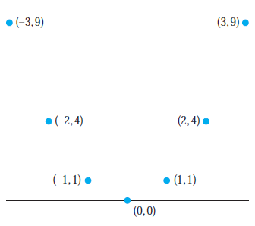
Function – Graphs of Functions
Let f be a function from the set A to the set B. The graph of the function f is the set of ordered pairs {(a,b) | a ∈A and f(a) = b}.
Example 01

Slide 138
Function – Graphs of Functions
Let f be a function from the set A to the set B. The graph of the function f is the set of ordered pairs {(a,b) | a ∈A and f(a) = b}.
Example 02

Slide 139
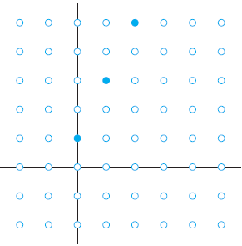
Function – Graphs of Functions
Let f be a function from the set A to the set B. The graph of the function f is the set of ordered pairs {(a,b) | a ∈A and f(a) = b}.
Example 02

Slide 140
Function – Important Functions

Slide 141
Function – Important Functions
The floor function, denoted by

Slide 142
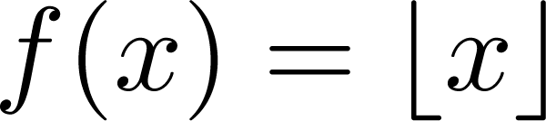
Function – Important Functions
The floor function, denoted by

Slide 143
Function – Important Functions
The floor function, denoted by
The largest integer less than or equal to x

Slide 144
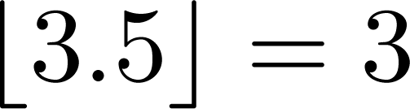
Function – Important Functions
The floor function, denoted by
The largest integer less than or equal to x

Slide 145
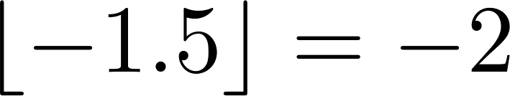
Function – Important Functions
The floor function, denoted by
The largest integer less than or equal to x

Slide 146
Function – Important Functions
The floor function, denoted by
The largest integer less than or equal to x

Slide 147
Function – Important Functions
The floor function, denoted by
The largest integer less than or equal to x
The ceiling function, denoted by

Slide 148
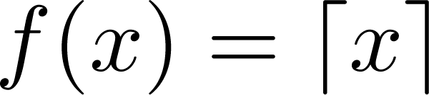
Function – Important Functions
The floor function, denoted by
The largest integer less than or equal to x
The ceiling function, denoted by

Slide 149
Function – Important Functions
The floor function, denoted by
The largest integer less than or equal to x
The ceiling function, denoted by
the smallest integer greater than or equal to x

Slide 150
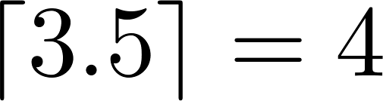
Function – Important Functions
The floor function, denoted by
The largest integer less than or equal to x
The ceiling function, denoted by
the smallest integer greater than or equal to x

Slide 151
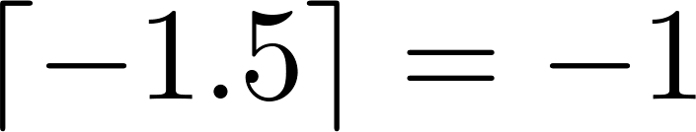
Function – Important Functions
The floor function, denoted by
The largest integer less than or equal to x
The ceiling function, denoted by
the smallest integer greater than or equal to x

Slide 152
Function – Important Functions
The floor function, denoted by
The largest integer less than or equal to x
The ceiling function, denoted by
the smallest integer greater than or equal to x

Slide 153
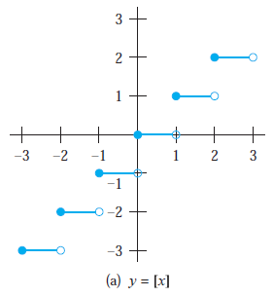
Function – Important Functions

Slide 154
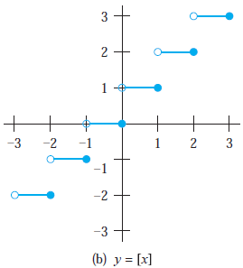
Function – Important Functions

Slide 155
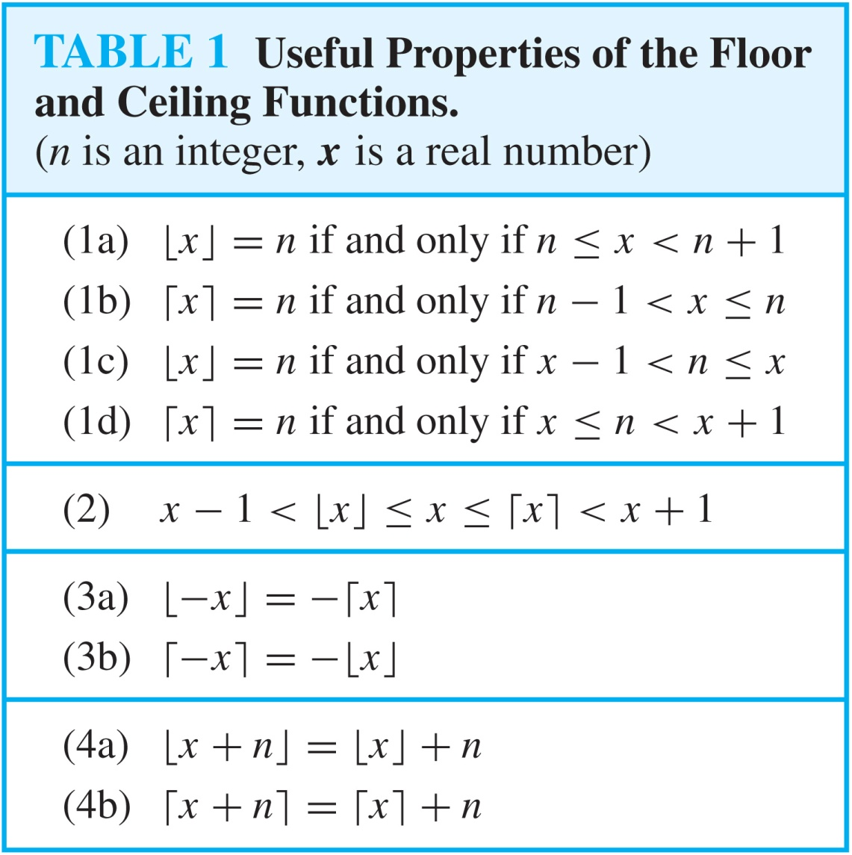
Function – Properties of floor & ceiling

